Slide 1
Wireless Security in Academia
By Patrick Trinkle
tri1@umbc.edu
November 27th, 2006

Slide 2
Agenda
Abstract
Introduction
Background
Methods
Results
Discussion
Conclusion

Slide 3
Abstract
Universities implementing unencrypted wireless internet access to students allows for serious privacy concerns
Enforcement of policies regarding security for student run wireless access points on the school network is fairly complicated.

Slide 4
Introduction
Students and Faculty use mobile communications on campus—this should be more easily enabled by the university.
Universities are extreme enterprise networks, handling massive amounts of users with no single device per user.
Handling authentication is important, while encryption is not addressed.

Slide 5
Introduction (cont)
UMBC uses 802.11b and 802.11g standards.
Data transmitted in the air is easy to target.
802.11 uses radio frequency transmission for communication.

Slide 6
Introduction (cont)
Data transmitted between the clients (users) and the access points includes non-public information (NPI).
NPI can include: usernames, passwords, SSNs, personal information, conversations, and contacts

Slide 7
Introduction (cont)
Students and Faculty attach wireless access points (WAP) to the network.
Access points are required to be “secure.”
Open access points are access points to the residential network exposing other users on the network to outside attackers.
WAPs often have excessive range.

Slide 8
Introduction (cont)
Open source software and COTS devices enable collections against wireless networks and wireless network discovery efforts.

Slide 9
Background
UMBCs Networks must handle many users.
Users of the network must authenticate themselves.
UMBC uses channels: 1, 3, 6, and 11.
UMBC does not use data encryption

Slide 10
Background (cont)
A student could inconspicuously capture traffic from many locations on campus.
Enforcing policies regarding WAPs on the residential network is difficult to enforce.

Slide 11
Methods
Hardware
  Dell Inspiron 700m Laptop
  Cisco Aironet 350
  5-dBi range extending blade antenna
Software
  Microsoft Windows XP Professional
  Airodump 2.3 (Aircrack 2.41 Suite)
  Ethereal 0.99.0
  Netstumbler 0.4.0

Slide 12
Methods (cont)
Staged two different passive collections:
  Channel-hopping: rotates 0 to 14
  Channel-specific: 11
Collected for 1 hour a day, 5 days
  Monday through Friday, around lunchtime
Passive collection is impossible to detect via the network (wireless only)

Slide 13
Passive Listening Attack Diagram
AP
B
C
A
AP
Attacker
D
E
F
Notes:
The Orange Dashed Circles represent the range of the Wireless Access Points
The White Circles represent the range of the Wireless Clients
The Red Circle represents the range of the Attacker

Slide 14
Methods (cont)
Site Survey for WAPs
  Locations near dormitories
  8 Locations chosen
  Ignored networks appearing to belong to UMBC

Slide 15
Search for Open Networks Diagram
Building A
Building B
Attacker
Notes:
The Red Circle is the range of the Attacker
The White Circles are the ranges of the Wireless Access Points
The Green Octagons are the Wireless Access Points
Note: Ranges are not proportionate and are for demonstration purposes only

Slide 16
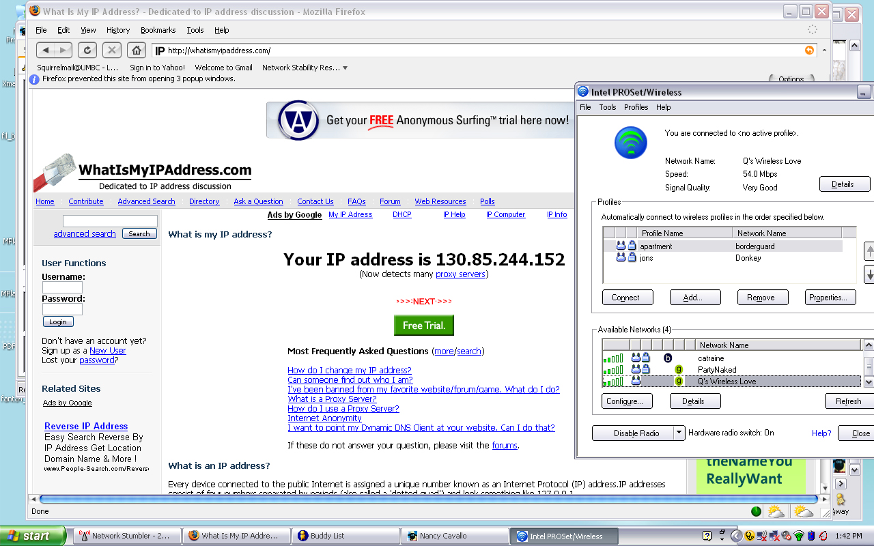

Slide 17
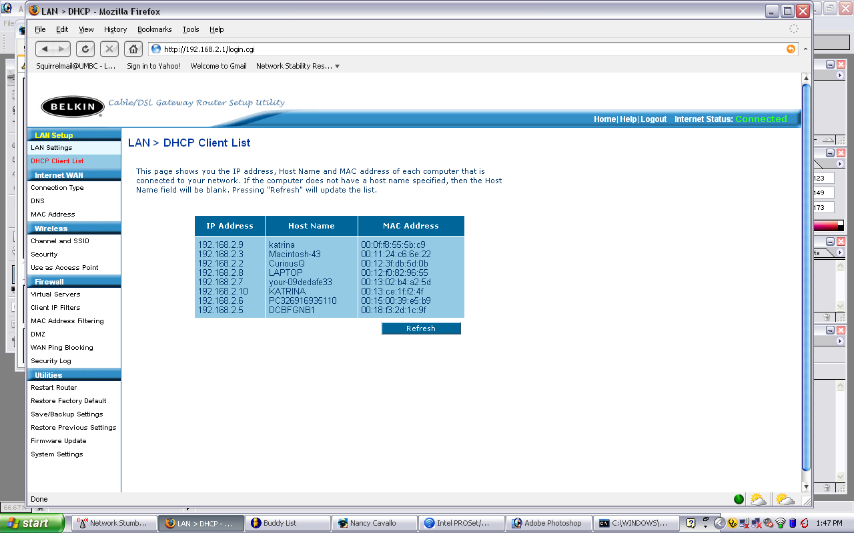
Example Of Open Network with Unsecured WAP

Slide 18
Methods (cont)
Ethereal Filters
  AIM (AOL Instant Messenger)
  FTP (File Transfer Protocol)
  Telnet
  SMTP (Simple Mail Transfer Protocol)
  SNMP (Simple Network Management Protocol)
  HTTP(|S) (Hypertext Transfer Protocol (over SSL)
    Strings := password=, passwd=, pass=

Slide 19
Results
Initial Results:
  Packets: 7,897,969
  Bytes: 2,257,276,594
  Time: 9:59:39
AIM Traffic Analyzed
  Entire buddy lists
  Conversations
  Phone numbers

Slide 20
Results (Collections)
FTP Traffic
  IP Addresses for a number of anonymous FTP servers
Telnet Traffic
  Minimal
SMTP Traffic
  Minimal
SNMP Traffic
  None

Slide 21
Results (Collections)
HTTP(|S)
  GET|POST requests can reveal information entered by user
  Cookies also reveal information stored on client
  25 total usernames and passwords were collected
  Only examined plaintext, not base64

Slide 22
Results (Site Survey)
War-driving both on foot and in vehicle.
Never approached by students of campus police.
At each site, substantial number of WAPs.
On average 34% were open.
  Open := no encryption mechanism in place
Survey could not have possibly found all networks, nor was this the purpose.

Slide 23
Discussion
Privacy of data is critical.
Authentication of users is paramount.
Currently there is a lack of privacy.
Users often reuse passwords across sites, therefore in theory more passwords can be derived from those collected.
Client computers have a personal identiy when linked to Myspace and AIM

Slide 24
Discussion (Collections)
Solutions
  WPA-PSK → Require all clients to know key, key rotation difficult, bad
  WEP2 → Require all clients to know key, key rotation difficult, bad
  PKI → Heavy to implement, maybe
  NiAB → Easy to implement, uses PKI model, key rotation is automatic, revocation is easy, maybe

Slide 25
Discussion (Site Survey)
Attaching WAPs can lead to serious problems
  Theft of service
  Tunneling of illicit materials
  Non-authenticated access to UMBC networks
Enforcement
  Site Survey
  Trust in education of users
  Residential Assistant Registration of devices

Slide 26
Conclusion
A large security gap was discovered at UMBC.
The convenience vs. cost model plays a large part in enterprise wireless security.
An attacker can collect gigabytes of traffic in a relatively short time.
There are potential solutions to UMBCs network needs.

Slide 27
Conclusion (cont)
Policy enforcement is difficult.
Education of users is important and feasible.

